Slide 1
Observational Astronomy Astrometry
University of Texas Rio Grande Valley
Center for Gravitational Wave Astronomy
Nompuewenu Observatory
Brownsville - 2016

Slide 2
Precision in Astrometry
Astrometry of minor bodies consists in measuring the apparent position of an object projected on the celestial sphere at a given instant of time. These two parameters position and time must be measured
Fractions of an arc second for the position.
Fractions of a second.

Slide 3
Objetivos de la Astrometría
Measurements shall be reported to the Minor Planet Center (MPC), the institution that collects and stores all the astrometries of minor bodies performed all over the world.
The information is used to:
Improve calculations for the orbits of asteroids, TNOs, comets, etc.
Generate trusted ephemeris which would facilitate tracking of the objects.

Slide 4
Equipment and resources needed
Telescope with equatorial mount capable of tracking an object for several minutes.
Monochrome CCD.
Computer.
Celestial chart.
Stellar catalogs.
Minor bodies catalogs.
Software to perform astrometry.
Software to adjust the computer clock.
Internet connection.

Slide 5
Internet connectivity
Internet will permit
To correct the computer clock.
To generate ephemeris of the object to be observed.
To obtain a list of the objects to be observed.
To obtain the list of object with confirmation pending.
To obtain previous observations of an object.
To access catalogs and data base updates of minor bodies stars and a list of de observatories with MPC code.
Submit reports to the MPC.

Slide 6
Relative Astrometry
The measurement of a celestial body’s position is called relative when it is compared with the position of reference stars that appear in the same FOV.
The coordinates (RA and DEC) of the reference star (RA and DEC) shall be known.
The asteroid coordinates can be obtain measuring its position to respect of the known surrounding stars.
There are several pieces of software which would do this task.
The one we will be using is “Astrometrica” by Hebert Raab.

Slide 7
Procedures to perform the relative astrometry
We need to have images from the object we want to measure in the FIT format.
We use as reference stars:
The ones appearing in the FIT file.
The coordinates shall be known (RA ; DEC).
We determine the coordinates (X ; Y) in the image:
of the object.
of the reference stars.
We calculate the RA and DEC of the object.

Slide 8
Control del reloj de la computadora
Usually the time registered by the computer during the capture of the image is saved in a file by the software controlling the CCD.
Time synchronization of the computer clock shall be precise to the second.
There is a piece of free software called “Dimension 4” which allows to synchronize the computer clock with a standard time.

Slide 9
Catálogos de estrellas
There are many catalogs essentially covering all the sky with the know coordinates for a vast amount of stars.
The ones we will be using are:
USNO A2.0 (~ year 2000) - Positions and magnitudes of 526 million stars up to magnitude 19. No information about stars proper motion.
UCAC4 (2012) - Position and proper motion of up to 113 million stars up to magnitude 16.
GAIA – Just published: most complete and precise one.

Slide 10
Minor bodies catalogs
There are several catalogs with the orbital elements of all known minor bodies.
We will use the MPCORB offered by MPC:
http://www.minorplanetcenter.net/iau/MPCORB.html
Astrométrica allows downloads from the site.

Slide 11
Information to provide in an astrometry
All the information to be provided in an astrometry is reported in one line to be reported to the MPC.
Astrometry information :
Object denomination.
Date and time of image capture (UT).
RA and DEC of the object.
Object magnitude (optional).
Position from where the observation was made (MPC code).

Slide 12
Steps to observe
Select object to be observed.
Look for object coordinates.
Point the telescope to the coordinates of the object
Identify the field and center the image keeping star references in the FOV.
Focus the optical system.
Open a subfolder with the object name in the folder named with the date in which the observation takes place.
Define: exposure time, binning and number of images.
Control observing conditions: observatory weather, instrumentation and computer lights observation window, clock synchronization, etc.
Start the image capturing naming and ordering them appropriately.
Control that the object and the reference stars do not exceed the linearity limit.
Calibrate the images.
Reduce the images.
Identify the object of interest. el objeto a medir
Perform astrometries (at least three).
Verify the quality of the astrometries.
Prepare report and submit to MPC.

Slide 13
Minor Planet Center (MPC)
MPC is charge with:
Gather, processing and organization of all minor bodies astrometries throughout the world.
Identify observed objects and their orbits.
Request measurements and searches for objects needing followup.
assigning temporary and permanent names to minor bodies.
Disseminate on a daily basis all the obtained information.
Assigning identification codes and accrediting observatories participating in minor bodies searches and identification.
Founded in 1947, at the University of Cincinnati.
SInce 1978 functions at the Smithsonian Astrophysical Observatory (SAO) from Harvard, University in Cambridge, MA under the auspice of the International Astronomical Union (IAU).
Each observatory proportioning astrometries, has an MPC code which allows to identify in an unequivocal manner the position of the observations.
During 2010 there were 400 MPC active codes.

Slide 14
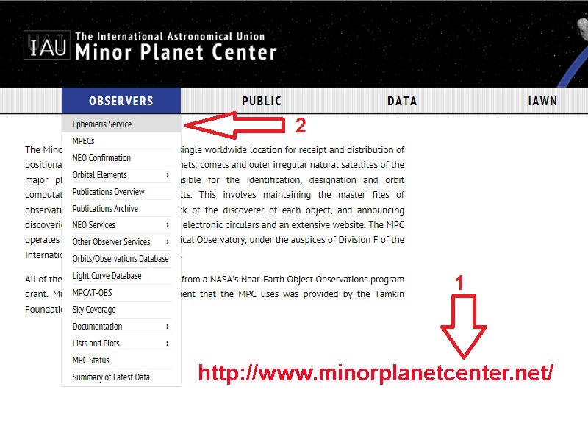
Minor bodies ephemerides

Slide 15
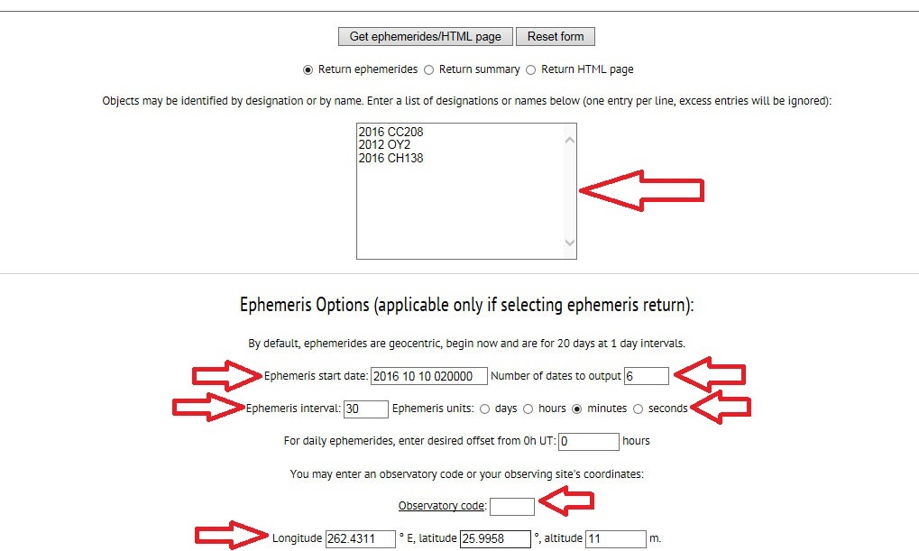
Minor bodies ephemerides

Slide 16
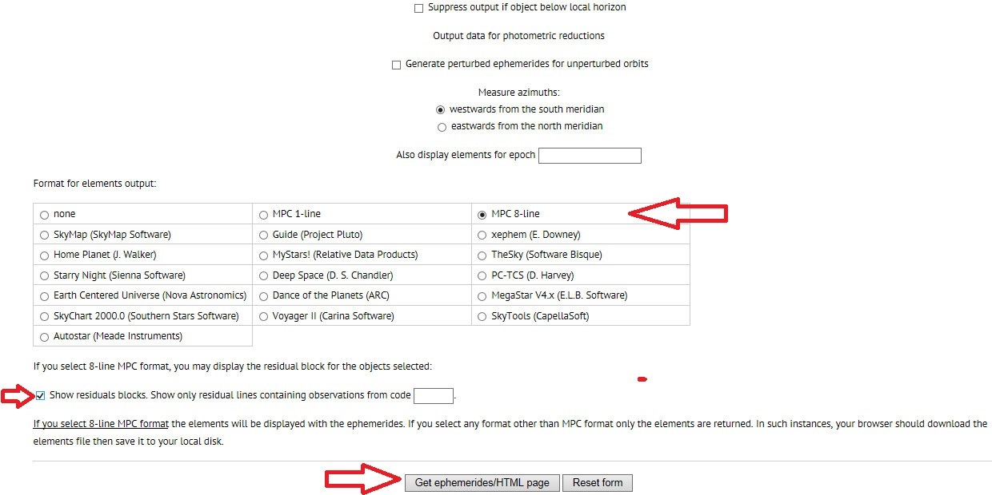
Minor bodies ephemerides

Slide 17
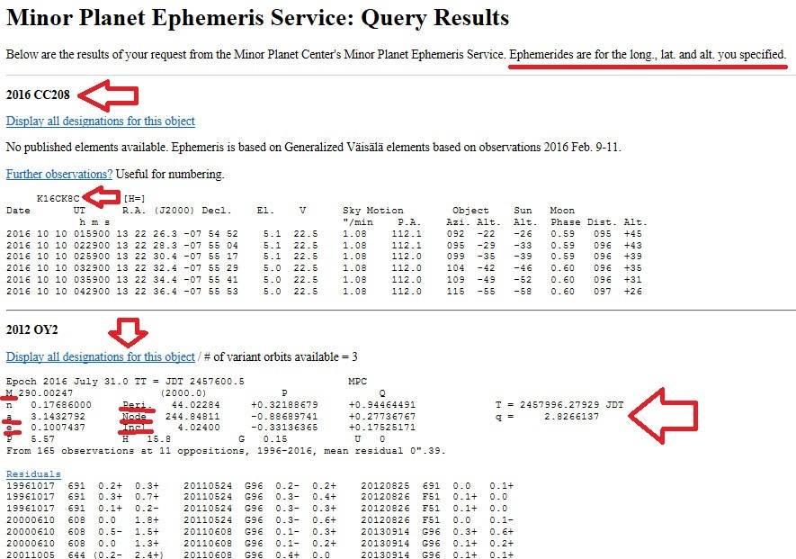
Minor bodies ephemerides

Slide 18
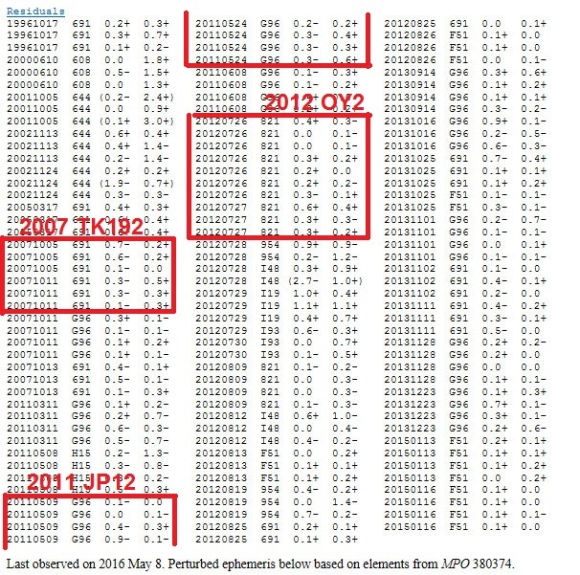
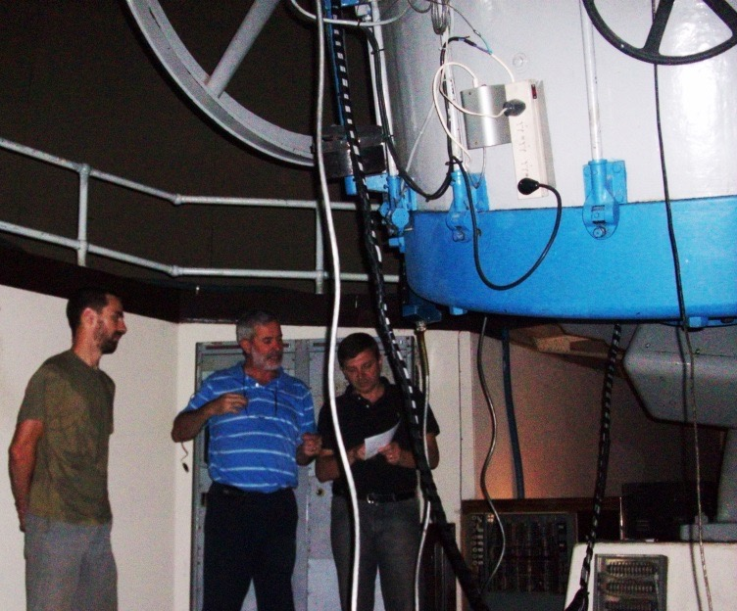
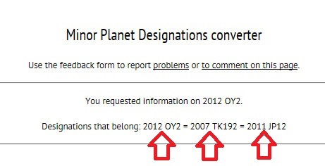
Residuals of astrometries

Slide 19
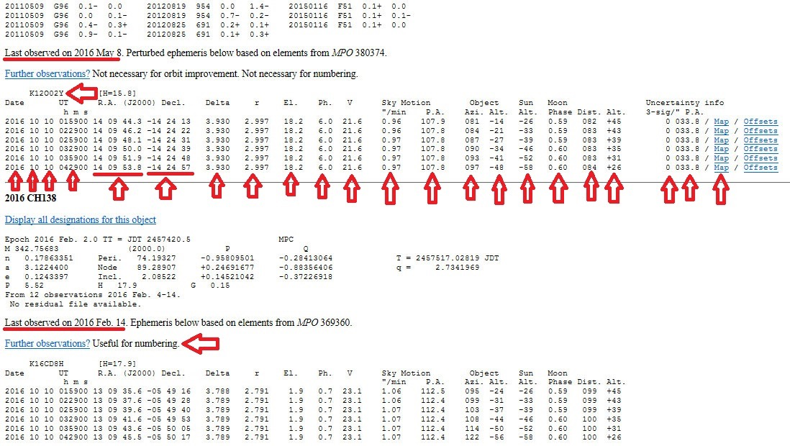
Minor bodies ephemerides

Slide 20
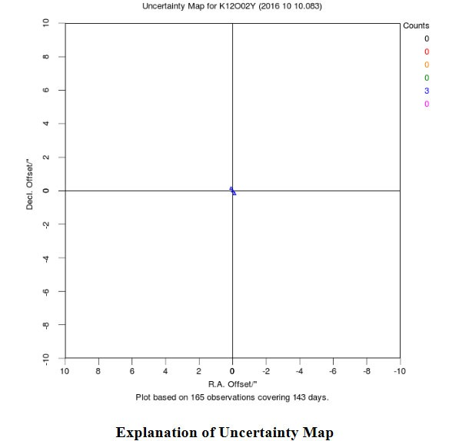
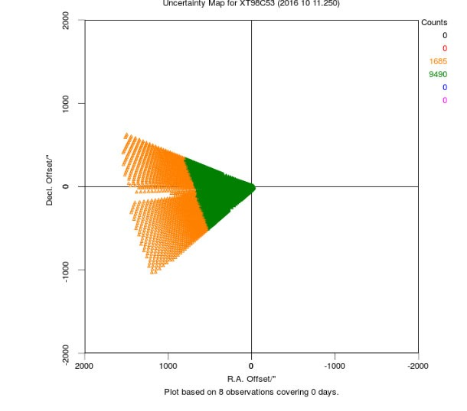
MPC uncertainty maps

Slide 21
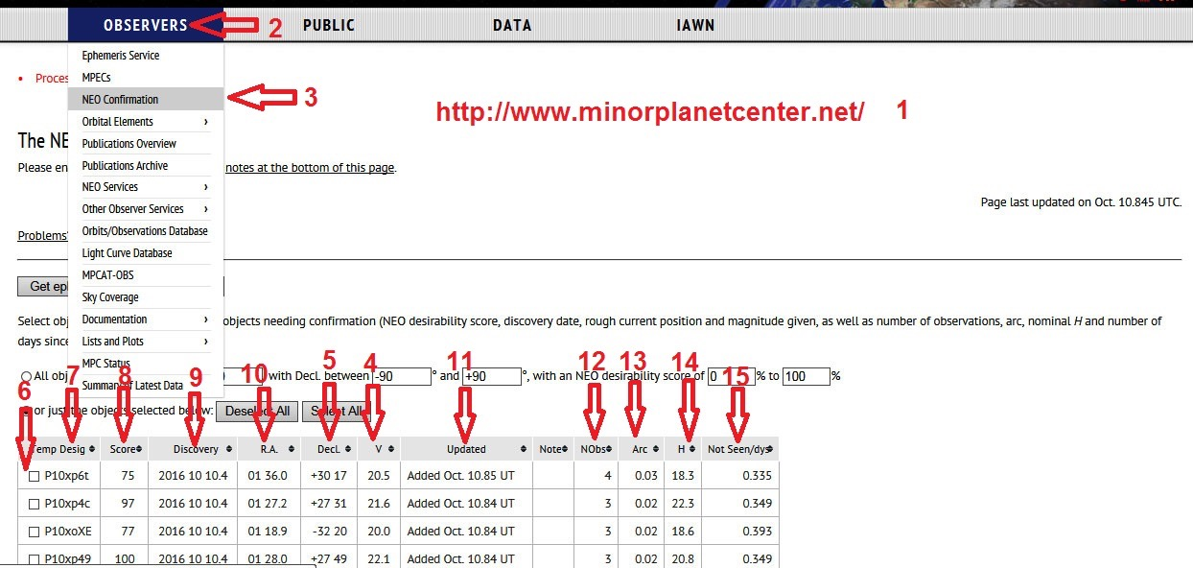
Discovery confirmations

Slide 22
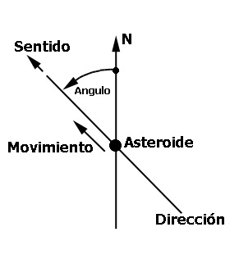
Apparent motion of an object
Ato described the apparent motion of an object on the celestial sphere, conventions determining the direction and angle of motion were adopted.
The motion angle (PA), is measured from the object’s North to the vector representative of object’s motion.
It is measure in degree, arc minutes and
arc seconds.
It goes from 0 to 360º Eastward.
DIrection
PA
Asteroid

Slide 23
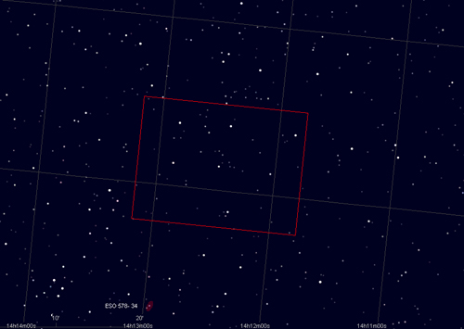
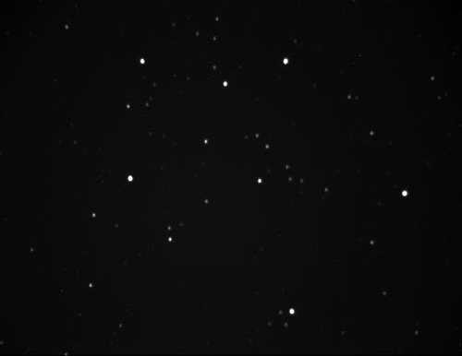
Celestial Charts
Before searching for an object, it is convenient to localize it in a celestial chart according to the object ephemeris at the time of observation.
The map shall allow to compare its details with the CCD FOV .
The one we will be using is called “Cartes du ciel” and is free software.

Slide 24
MPC Data Base
The MPC data base is public.
Many institutions use this information to conduct their own observations.
New will be using these observations to control the compatibility of our own measurements with the existing ones, before reporting them (to this effect we will use the software Find_Orb).
The astrometries for any object can be obtained at:
http://www.minorplanetcenter.net/db_search

Slide 25
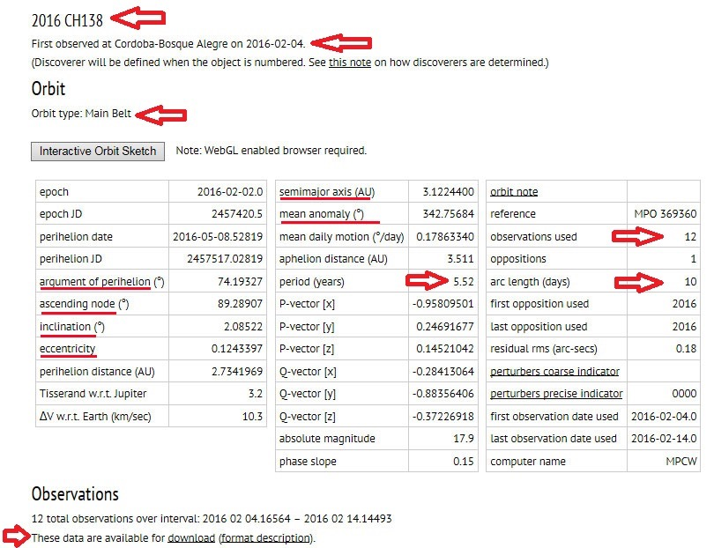
Orbital Elements

Slide 26
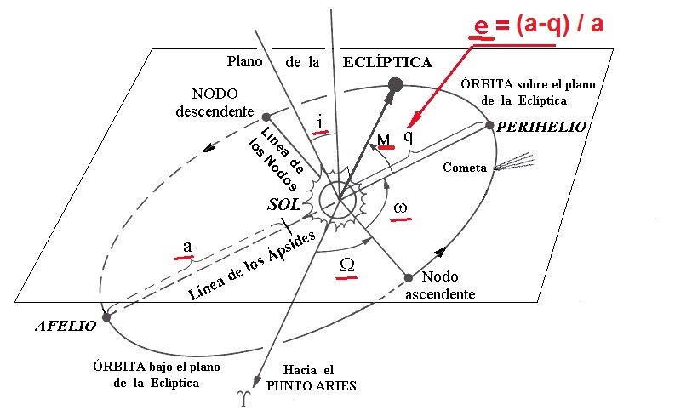
Orbital Elements

Slide 27
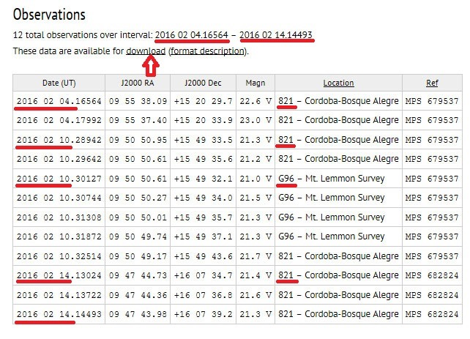
Previous observations

